Slide 1
Sign Language Recognition
By,
Rimzim Thube
Shree Gowri Radhakrishna
Vijaylaxmi Nagurkar

Slide 2
Objective
Sign Language used by people with hearing disability to communicate with others
Difficult to communicate if the language is not understood
Creates a barrier for hearing disabled to lead a normal life
To improve their quality of life, develop an application for gesture recognition in real time
Use latest Deep Learning models
Can be used in mobile devices

Slide 3
Dataset
No ready dataset available for Auslan language
AUSLAN dataset generated from frames of YouTube videos demonstrating the hand gestures
Images are annotated with their class labels
Coordinates of the bounding box covering the gesture
Images are crowdsourced on Amazon DataTurk for labelling

Slide 4
Data preparation: cleaning, preprocessing
Frames taken from video showing AusLan sign language
From Amazon dataturks
Annotated JSON files containing the image URL, height, width, bounding box vertices
Save the images in local storage and the metadata in text file to run bounding box regresser

Slide 5
Bounding Box
Used YOLO algorithm for object detection
Built a Resnet model with Data Augmentation
trained, tuned and tested
Regresser able to detect the bounding box of newly captured video

Slide 6
Methods
The final goal that was to be achieved was to create a web application that uses a computer’s webcam to capture a person signing the Auslan alphabet, and translate it in real time. The steps taken to achieve the following were:
We gathered data
Trained a machine learning model by providing it a set of images to recognise the Auslan Alphabet.
Post training , we saved the model
Build the user interface i.e the client and the application side using the pretrained model.

Slide 7
User Interface
The backend service, given an image of a sign, returns the predicted letter, and; the front-end that captures and displays video from the user’s webcam and ask the backend for predictions.
For the backend, we are using Flask app (Python) — a POST request with the image as the payload would return us the 4 points of the bounding box and the class (or letter) of the image. On the client side, we are using Javascript to capture the users’ webcam with the browser’s getUserMedia method and using an invisible canvas we took a frame from the video every 2000ms, request a prediction, and display the results accordingly.

Slide 8
Model Architecture
Yolo
YOLO is a clever convolutional neural network (CNN) for doing object detection in real-time. The algorithm applies a single neural network to the full image, and then divides the image into regions and predicts bounding boxes and probabilities for each region. We are using the algorithm to implement bounding boxes in our application

Slide 9
Model Architecture
Transfer learning using - Resnet101 model
Size - 224
Batch size - 32
Image Augmentation - fastai.ImageClassifierData

Slide 10
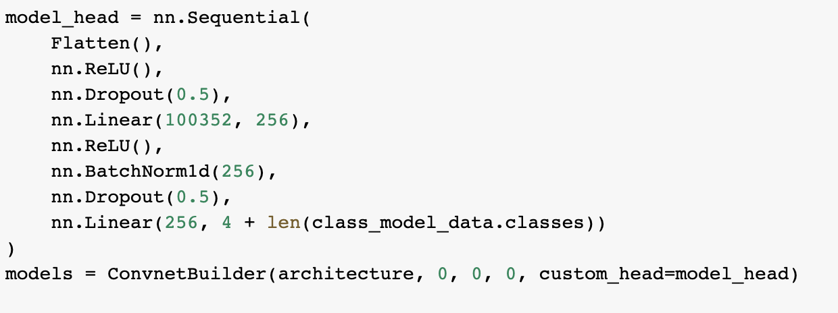
Customised the Resnet model using ConvnetBuilder

Slide 11
Model Training
Bounding Box detector: Resnet model trained on the Amazon Turks dataset to automatically detect bounding box around the sign in the image. Experiment with Data Augmentation and fine tuning the number of layers in the model, loss, learning rate and so on.
CNN classification: Built a Sequential model with Relu activations, dropouts and batch normalization. Experiments with different values for these hyper-parameters.
Tried various values of learning rates and epochs to improve the performance of the model
Added more data to the training set to improve accuracy of the model.

Slide 12
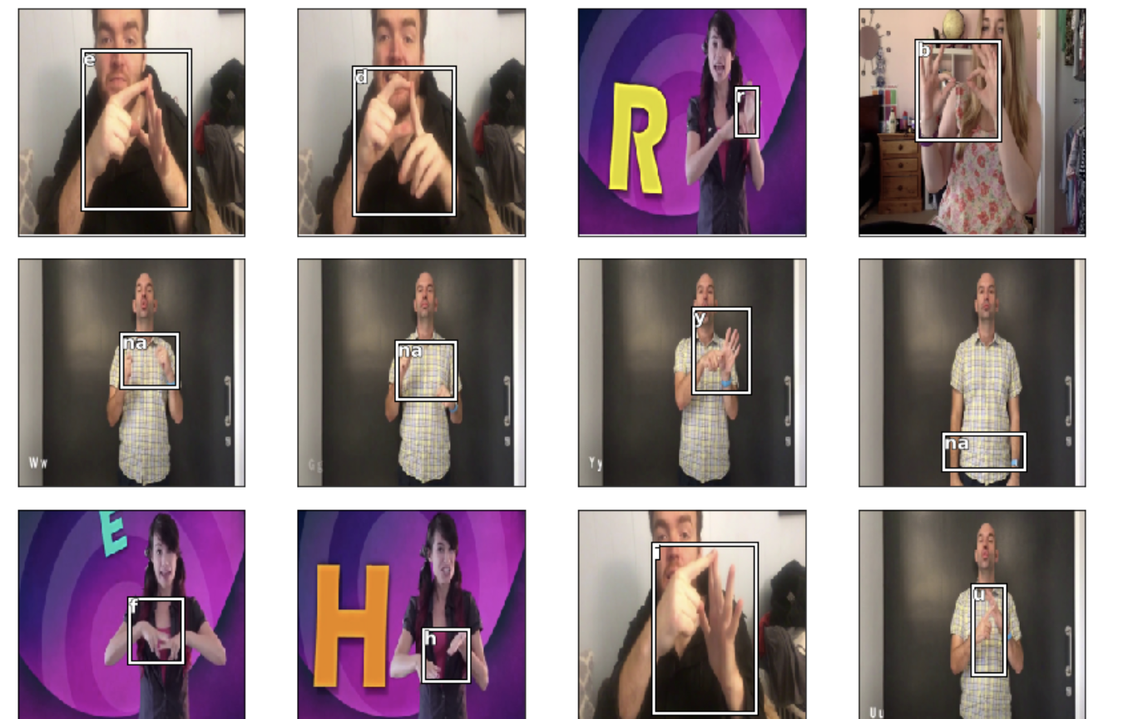
Trained model used to test the captions on the images

Slide 13
Existing Model
Model based on sign language detection
https://medium.com/@coviu/how-we-used-ai-to-translate-sign-language-in-real-time-782238ed6bf

Slide 14
Conclusion
Built a CNN Resnet model to detect sign language
Trained on AusLan dataset
Inference tests to validate the model
Flask end-to-end application to capture live video and predict on the saved model
Can be extended to other Sign Languages like ASL

Slide 15
Thank you

